Slide 1
生成式对抗网络 GAN Generative adversarial networks
中国科学院自动化研究所
吴高巍
gaowei.wu@ia.ac.cn
2020-10-25

Slide 2
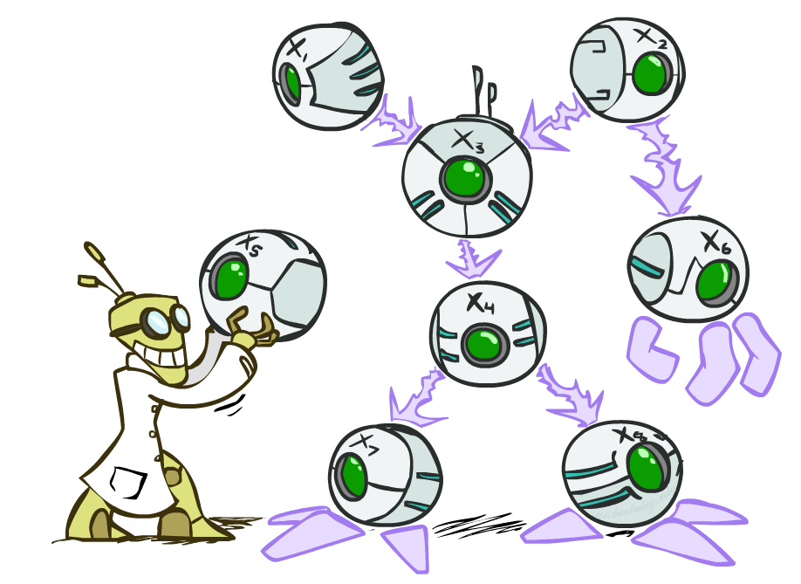
内容
GAN的理论与实现模型
不同类型GAN
对抗学习

Slide 3
GAN的理论与实现模型

Slide 4
GAN背景
人工智能的热潮
人工智能分为两个阶段：感知阶段和认知阶段
都涉及理解这个环节
GAN具有生成数据样本的能力。
这种能力在一定程度上反映了它对事物的理解。
GAN 有望加深人工智能的理解层面的研究。
“What I cannot create, I do not understand. (不可造者, 未能知也.)”
—— Feynman
“过去十年间机器学习领域最让人激动的点子”
——Yann LeCun
Notes:
在感知阶段, 机器能够接收来 自外界的各种信号, 例如视觉信号、听觉信号等, 并 对此作出判断, 对应的研究领域有图像识别、语音识别等.
在认知阶段, 机器能够对世界的本质有一定的 理解, 不再是单纯、机械地做出判断。
理解无论对人类还是人工智能都是内在的表现, 无法直接测量, 只能间接从其他方面推测. 如何衡量人工智能的理解程度, 虽然没有定论但是著名学者 Feynman 名言
这说明机器制造事物的能力从某种程度上取决于机器对事物的理解.

Slide 5
GAN背景
生成式模型的积累
密度估计
样本生成
Notes:
密度（概率）估计：就是说在不了解事件概率分布的情况下，先假设随机分布，然后通过数据观测来确定真正的概率密度是怎样的。
样本生成：这个就更好理解了，就是手上有一把训练样本数据，通过训练后的模型来生成类似的「样本」。

Slide 6
生成模型
Maximum Likelihood
Notes:
该怎么创造生成模型呢？这涉及到概率领域一个方法：最大似然估计。

Slide 7
Taxonomy of Generative Models
Notes:
整个生成模型的大家族
大家都同根于最大似然玩法，但是有着显隐密度的区分。大多数你们听过的强大的生成模型都需要用到马尔可夫链，而 GAN 是目前唯一一种直接从数据观测的一步到位的生成模型。

Slide 8
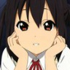

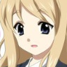
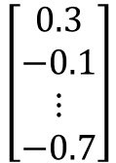
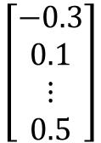
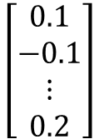
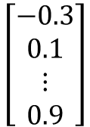
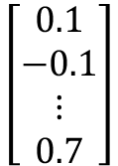
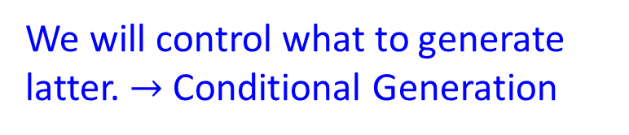
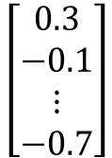
生成模型
We will control what to generate latter. $→$ Conditional Generation
Image Generation
NN
Generator
$$\left[\begin{aligned}0.3 \\ −0.1 \\ ⋮ \\ −0.7\end{aligned}\right]$$
$$\left[\begin{aligned}0.1 \\ −0.1 \\ ⋮ \\ 0.7\end{aligned}\right]$$
$$\left[\begin{aligned}−0.3 \\ 0.1 \\ ⋮ \\ 0.9\end{aligned}\right]$$
In a specific range
Sentence Generation
$$\left[\begin{aligned}0.3 \\ −0.1 \\ ⋮ \\ −0.7\end{aligned}\right]$$
$$\left[\begin{aligned}0.1 \\ −0.1 \\ ⋮ \\ 0.2\end{aligned}\right]$$
$$\left[\begin{aligned}−0.3 \\ 0.1 \\ ⋮ \\ 0.5\end{aligned}\right]$$
NN
Generator
How are you?
Good morning.
Good afternoon.
Notes:
GAN的功能，做什么用的

Slide 9
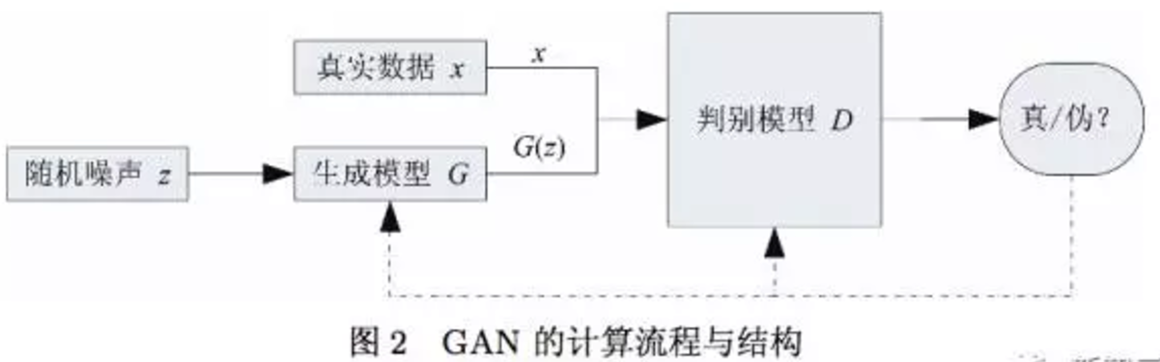
GAN基本原理
GAN 的核心思想来源于博弈论的纳什均衡
一个生成器 (Generator)和一个判别器 (Discriminator)
生成器的目的是尽量去学习真实的数据分布
判别器的目的是尽量正确判别输入数据是来自真实数据还是来自生成器
各自提高自己的生成能力和判别能力, 这个学习优化过程就是寻找二者之间的一个纳什均衡
Notes:
二人零和博弈 (即二人的利益之和为零, 一方的所得正是另一方的所失) 的启发, 系统由一个生成器和一个判别器构成。生成器捕捉真实数据样本的潜在分布, 并生成新的数据样本; 判别器是一个二分类器, 判别输入是真实数据还是生成的样本
GAN 的优化过程是一个极小极大博弈 (Minimax game) 问 题, 优化目标是达到纳什均衡 , 使生成器估测到数据样本的分布。
这两个相互对抗并迭代优化的过程使得 D 和 G 的性能不断提升, 当最终 D 的判别能力提升到一 定程度, 并且无法正确判别数据来源时, 可以认为这 个生成器 G 已经学到了真实数据的分布.

Slide 10
对抗网络框架
Notes:
简单打个比方就是：两个人比赛，看是 A 的矛厉害，还是 B 的盾厉害。比如，我们有一些真实数据，同时也有一把乱七八糟的假数据。A 拼命地把随手拿过来的假数据模仿成真实数据，并揉进真实数据里。B 则拼命地想把真实数据和假数据区分开。
这里，A 就是一个生成模型，类似于卖假货的，一个劲儿地学习如何骗过 B。而 B 则是一个判别模型，类似于警察叔叔，一个劲儿地学习如何分辨出 A 的骗人技巧。
如此这般，随着 B 的鉴别技巧的越来越牛，A 的骗人技巧也是越来越纯熟。
一个造假一流的 A，就是我们想要的生成模型！

Slide 11
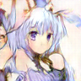


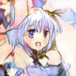
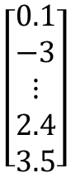
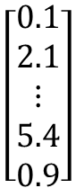
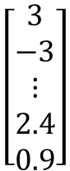
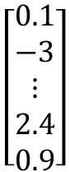
Basic Idea of GAN
Generator
high dimensional vector
image
vector
$$\left[\begin{aligned}0.1 \\ −3 \\ ⋮ \\ 2.4 \\ 0.9\end{aligned}\right]$$
Generator
Generator
$$\left[\begin{aligned}3 \\ −3 \\ ⋮ \\ 2.4 \\ 0.9\end{aligned}\right]$$
Each dimension of input vector represents some characteristics.
Longer hair
$$\left[\begin{aligned}0.1 \\ 2.1 \\ ⋮ \\ 5.4 \\ 0.9\end{aligned}\right]$$
Generator
$$\left[\begin{aligned}0.1 \\ −3 \\ ⋮ \\ 2.4 \\ 3.5\end{aligned}\right]$$
Generator
blue hair
Open mouth
http://mattya.github.io/chainer-DCGAN/

Slide 12

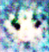
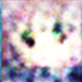
Basic Idea of GAN
Discri-minator
scalar
image
Larger value means real, smaller value means fake.
Discri-minator
Discri-minator
1.0
1.0
Discri-minator
Discri-minator
0.1
0.1

Slide 13
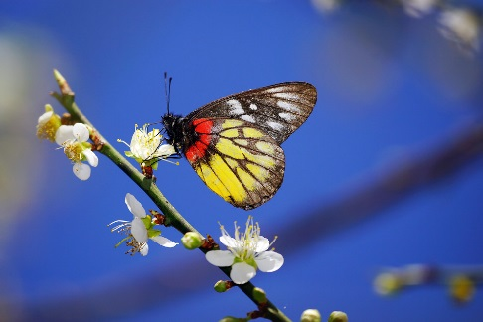
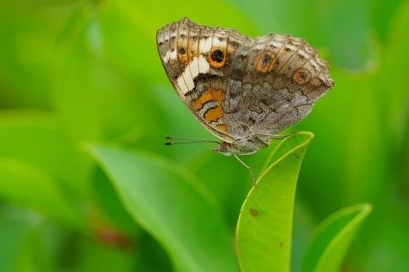
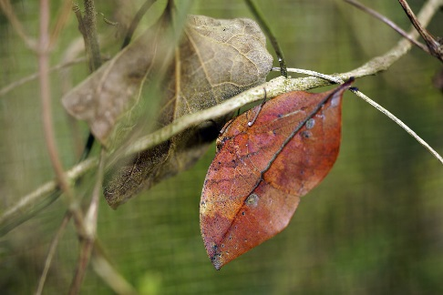
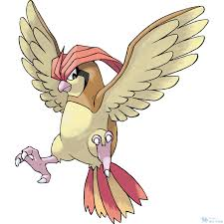
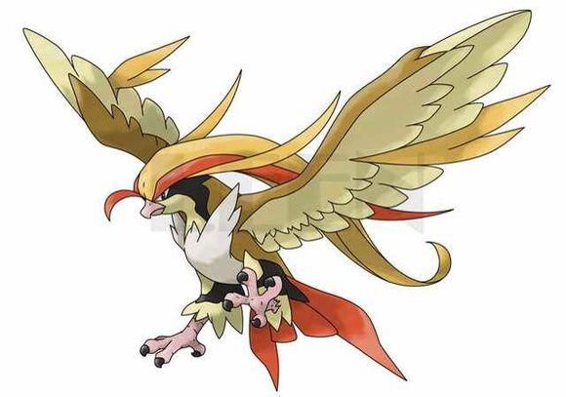
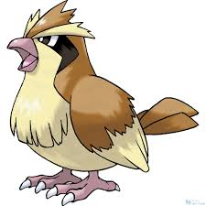
Basic Idea of GAN
Generator
Brown
veins
Butterflies are not brown
Butterflies do not have veins
……..
Discriminator
Notes:
Kallima inachus
Vein
dried leaf

Slide 14
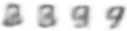
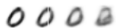
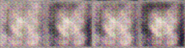
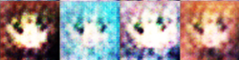
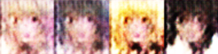
Basic Idea of GAN
NN
Generator
v1
NN
Generator
v2
NN
Generator
v3
This is where the term “adversarial” comes from.
Discri-minator
v1
Discri-minator
v2
Discri-minator
v3
Real images:
Generator v.s. Discriminator

Slide 15
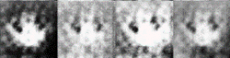
Basic Idea of GAN
Generator
(student)
Discriminator
(teacher)
Generator
v1
Discriminator
v1
没有两个圈
Generator
v2
Discriminator
v2
没有彩色
Generator
v3

Slide 16




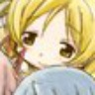
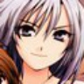

Algorithm
Initialize generator and discriminator
In each training iteration:
G
D
Step 1: Fix generator G, and update discriminator D
sample
Update
1
1
1
1
D
generated objects
Database
0
0
0
0
randomly sampled
G
vector
Fix
vector
vector
vector
Discriminator learns to assign high scores to real objects and low scores to generated objects.

Slide 17
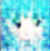
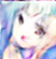
Algorithm
Initialize generator and discriminator
In each training iteration:
G
D
Step 2: Fix discriminator D, and update generator G
Generator learns to “fool” the discriminator
hidden layer
NN
Generator
Discri-minator
0.13
vector
update
fix
Gradient Ascent
large network

Slide 18
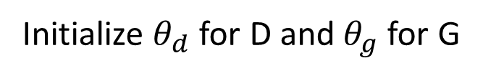
Algorithm
Initialize $θ_{d}$ for D and $θ_{g}$ for G
Learning
D
Learning
G
Notes:
位什麼要 1- 啊

Slide 19
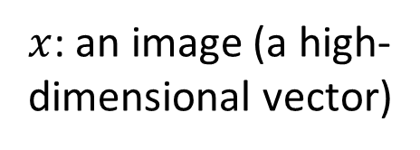
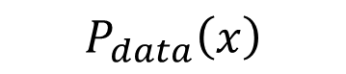
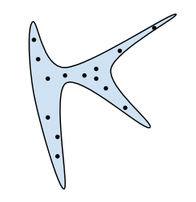
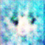
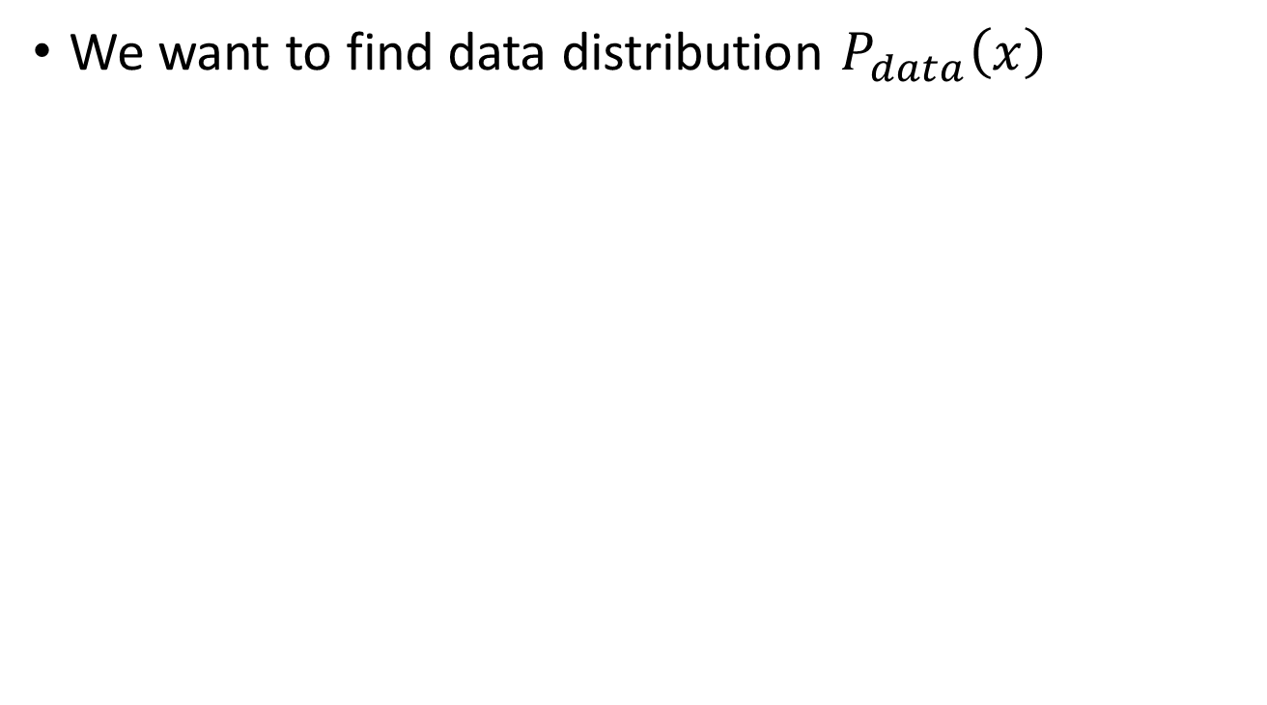
Theory behind GAN
Generation
We want to find data distribution P_{data}(x).
High
Probability
Image
Space
Low
Probability

Slide 20
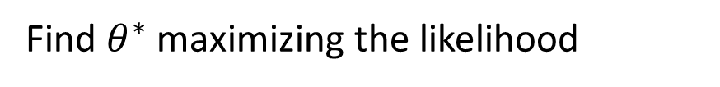
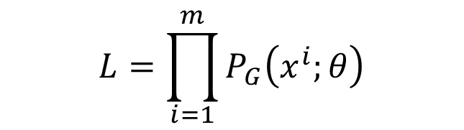
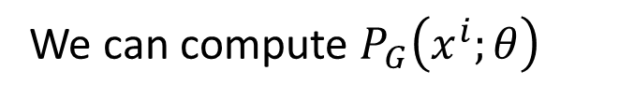
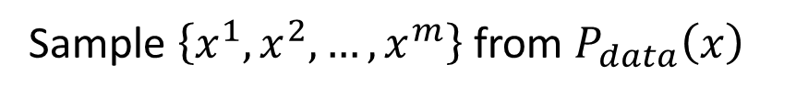
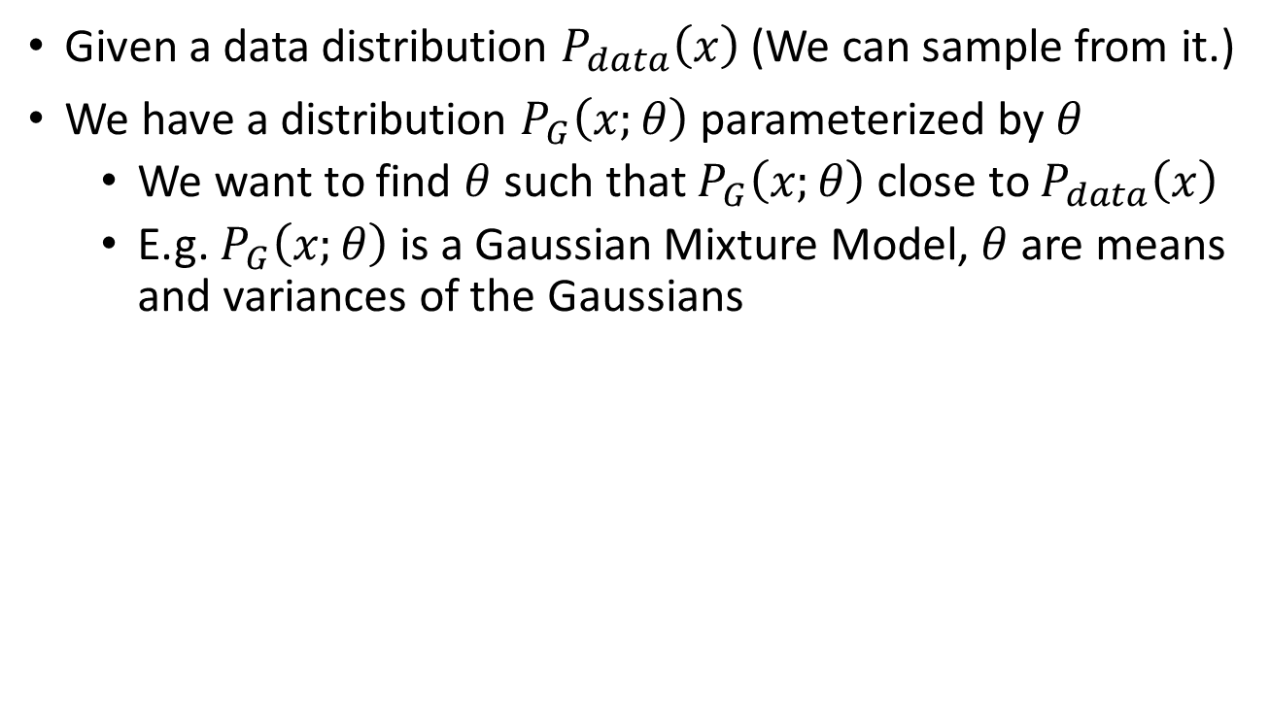
Maximum Likelihood Estimation
Given a data distribution $P_{data}\left(x\right)$ (We can sample from it.)
We have a distribution $P_{G}\left(x;θ\right)$ parameterized by $θ$
We want to find $θ$ such that $P_{G}\left(x;θ\right)$ close to $P_{data}\left(x\right)$
E.g. $P_{G}\left(x;θ\right)$ is a Gaussian Mixture Model, $θ$ are means and variances of the Gaussians
Sample $\left\{x^{1},x^{2},…,x^{m}\right\}$ from $P_{data}\left(x\right)$
We can compute $P_{G}\left(x^{i};θ\right)$
Likelihood of generating the samples
$$L=\prod_{i=1}^{m}{P_{G}\left(x^{i};θ\right)}$$
Find $θ^{∗}$ maximizing the likelihood

Slide 21
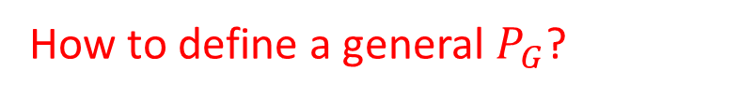
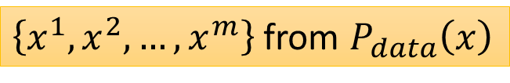
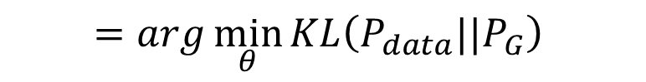
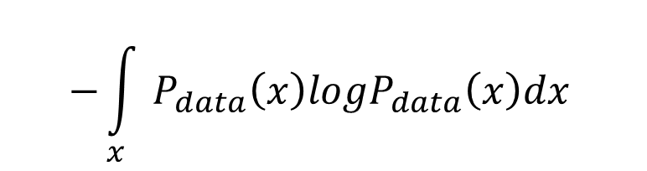





Maximum Likelihood Estimation
Maximum Likelihood Estimation = Minimize KL Divergence
$$θ^{∗}=arg\max_{θ}{\prod_{i=1}^{m}{P_{G}\left(x^{i};θ\right)}}$$
$$=arg\max_{θ}{log\prod_{i=1}^{m}{P_{G}\left(x^{i};θ\right)}}$$
$$=arg\max_{θ}{\sum_{i=1}^{m}{logP_{G}\left(x^{i};θ\right)}}$$
$\left\{x^{1},x^{2},…,x^{m}\right\}$ from $P_{data}\left(x\right)$
$$≈arg\max_{θ}{E_{x\sim P_{data}}[logP_{G}\left(x;θ\right)] }$$
$$=arg\max_{θ}{\int_{x}{P_{data}\left(x\right)logP_{G}\left(x;θ\right)dx} }$$
$$−{\int_{x}{P_{data}\left(x\right)logP_{data}\left(x\right)dx} }$$
$$=arg\min_{θ}{KL\left(P_{data}||P_{G}\right) }$$
How to define a general $P_{G}$?

Slide 22









Generator
$x$: an image (a high-dimensional vector)
A generator G is a network. The network defines a probability distribution $P_{G}$
$$P_{G}\text{(}\text{x}\text{)}$$
$$P_{data}\left(x\right)$$
Normal Distribution
generator
G
$$z$$
$$x=G\left(z\right)$$
as close as possible
$$G^{∗}=arg\min_{G}{Div\left(P_{G},P_{data}\right)}$$
Divergence between distributions $P_{G}$ and $P_{data}$
How to compute the divergence?

Slide 23




Discriminator
$$G^{∗}=arg\min_{G}{Div\left(P_{G},P_{data}\right)}$$
Although we do not know the distributions of $P_{G}$ and $P_{data}$, we can sample from them.
sample
Database
Sampling from $P_{data}$
sample from normal
G
vector
vector
vector
vector
Sampling from $P_{G}$

Slide 24




Discriminator
$$G^{∗}=arg\min_{G}{Div\left(P_{G},P_{data}\right)}$$
: data sampled from $P_{data}$
Using the example objective function is exactly the same as training a binary classifier.
: data sampled from $P_{G}$
Discriminator
train
Sigmoid Output
Example Objective Function for D
$$V\left(G,D\right)=E_{x∼P_{data}}\left[logD\left(x\right)\right]+E_{x∼P_{G}}\left[log\left(1−D\left(x\right)\right)\right]$$
(G is fixed)
$$D^{∗}=arg\max_{D}{V\left(D,G\right)}$$
Training:
The maximum objective value is related to JS divergence.
[Goodfellow, et al., NIPS, 2014]

Slide 25

Discriminator
$$G^{∗}=arg\min_{G}{Div\left(P_{G},P_{data}\right)}$$
: data sampled from $P_{data}$
Training:
: data sampled from $P_{G}$
$$D^{∗}=arg\max_{D}{V\left(D,G\right)}$$
Discriminator
train
small divergence
hard to discriminate
(cannot make objective large)
Discriminator
train
large divergence
easy to discriminate

Slide 26





$$\max_{D}{V\left(G,D\right)}$$
$$V=E_{x∼P_{data}}\left[logD\left(x\right)\right]$$
$$+E_{x∼P_{G}}\left[log\left(1−D\left(x\right)\right)\right]$$
Given G, what is the optimal D* maximizing
Given x, the optimal D* maximizing
$$V=E_{x∼P_{data}}\left[logD\left(x\right)\right]+E_{x∼P_{G}}\left[log\left(1−D\left(x\right)\right)\right]$$
$$=\int_{x}{P_{data}\left(x\right)logD\left(x\right)}dx+\int_{x}{P_{G}\left(x\right)log\left(1−D\left(x\right)\right)}dx$$
$$=\int_{x}{\left[P_{data}\left(x\right)logD\left(x\right)+P_{G}\left(x\right)log\left(1−D\left(x\right)\right)\right]}dx$$
Assume that D(x) can be any function
$$P_{data}\left(x\right)logD\left(x\right)+P_{G}\left(x\right)log\left(1−D\left(x\right)\right)$$

Slide 27






$$\max_{D}{V\left(G,D\right)}$$
$$V=E_{x∼P_{data}}\left[logD\left(x\right)\right]$$
$$+E_{x∼P_{G}}\left[log\left(1−D\left(x\right)\right)\right]$$
Given x, the optimal D* maximizing
Find D* maximizing:
$$P_{data}\left(x\right)logD\left(x\right)+P_{G}\left(x\right)log\left(1−D\left(x\right)\right)$$
a
D
b
D
$$f\left(D\right)=alog(D)+blog\left(1−D\right)$$
$$\frac{df\left(D\right)}{dD}=a×\frac{1}{D}+b×\frac{1}{1−D}×\left(−1\right)$$
$$=0$$
$$a×\frac{1}{D^{∗}}=b×\frac{1}{1−D^{∗}}$$
$$D^{∗}=\frac{a}{a+b}$$
$$D^{∗}\left(x\right)=\frac{P_{data}\left(x\right)}{P_{data}\left(x\right)+P_{G}\left(x\right)}$$
0 <
< 1
Notes:
sigmoid

Slide 28











$$\max_{D}{V\left(G,D\right)}$$
$$V=E_{x∼P_{data}}\left[logD\left(x\right)\right]$$
$$+E_{x∼P_{G}}\left[log\left(1−D\left(x\right)\right)\right]$$
$$\max_{D}{V\left(G,D\right)}$$
$$=V\left(G,D^{∗}\right)$$
$$D^{∗}\left(x\right)=\frac{P_{data}\left(x\right)}{P_{data}\left(x\right)+P_{G}\left(x\right)}$$
$$=E_{x∼P_{data}}\left[log\frac{P_{data}\left(x\right)}{P_{data}\left(x\right)+P_{G}\left(x\right)}\right]$$
$$+E_{x∼P_{G}}\left[log\frac{P_{G}\left(x\right)}{P_{data}\left(x\right)+P_{G}\left(x\right)}\right]$$
$$\frac{1}{2}$$
$$=\int_{x}{P_{data}\left(x\right)log\frac{P_{data}\left(x\right)}{P_{data}\left(x\right)+P_{G}\left(x\right)}}dx$$
$$\frac{1}{2}$$
$$+\int_{x}{P_{G}\left(x\right)log\frac{P_{G}\left(x\right)}{P_{data}\left(x\right)+P_{G}\left(x\right)}}dx$$
2
$$+2log\frac{1}{2}$$
$$−2log2$$
2
Notes:
Converge

Slide 29







$$\max_{D}{V\left(G,D\right)}$$
$$\max_{D}{V\left(G,D\right)}$$
$$=V\left(G,D^{∗}\right)$$
$$D^{∗}\left(x\right)=\frac{P_{data}\left(x\right)}{P_{data}\left(x\right)+P_{G}\left(x\right)}$$
$$=−2log2+\int_{x}{P_{data}\left(x\right)log\frac{P_{data}\left(x\right)}{\left(P_{data}\left(x\right)+P_{G}\left(x\right)\right)/2}}dx$$
$$+\int_{x}{P_{G}\left(x\right)log\frac{P_{G}\left(x\right)}{\left(P_{data}\left(x\right)+P_{G}\left(x\right)\right)/2}}dx$$
$$=−2log2+KL\left(P_{data}||\frac{P_{data}+P_{G}}{2}\right)$$
$$+KL\left(P_{G}||\frac{P_{data}+P_{G}}{2}\right)$$
$$=−2log2+2JSD\left(P_{data}||P_{G}\right)$$
Jensen-Shannon divergence

Slide 30














$$G^{∗}=arg\min_{G}{Div\left(P_{G},P_{data}\right)}$$
$$\max_{D}{V\left(G,D\right)}$$
$$D^{∗}=arg\max_{D}{V\left(D,G\right)}$$
The maximum objective value is related to JS divergence.
$$V\left(G_{1} ,D\right)$$
$$V\left(G_{2} ,D\right)$$
$$V\left(G_{3} ,D\right)$$
$$V\left(G_{1} ,D_{1}^{∗}\right)$$
$$D$$
$$D$$
$$D$$
$$G_{1}$$
$$G_{2}$$
$$G_{3}$$
Divergence between $P_{G_{1}}$ and $P_{data}$

Slide 31



$$G^{∗}=arg\min_{G}{Div\left(P_{G},P_{data}\right)}$$
$$\max_{D}{V\left(G,D\right)}$$
$$D^{∗}=arg\max_{D}{V\left(D,G\right)}$$
The maximum objective value is related to JS divergence.
Initialize generator and discriminator
In each training iteration:
Step 1: Fix generator G, and update discriminator D
Step 2: Fix discriminator D, and update generator G
[Goodfellow, et al., NIPS, 2014]

Slide 32










Algorithm
$$G^{∗}=arg\min_{G}{\max_{D}{V\left(G,D\right)}}$$
$$L\left(G\right)$$
To find the best G minimizing the loss function $L\left(G\right)$,
$θ_{G}$ defines G
$$\frac{df\left(x\right)}{dx}=?$$
$$f\left(x\right)=max⁡\{f_{1}\left(x\right),f_{2}\left(x\right),f_{3}\left(x\right)\}$$
If $f_{i}\left(x\right)$ is the max one
$$f_{1}\left(x\right)$$
$$f_{3}\left(x\right)$$
$$f_{2}\left(x\right)$$

Slide 33



Algorithm
$$G^{∗}=arg\min_{G}{\max_{D}{V\left(G,D\right)}}$$
Given $G_{0}$
Find $D_{0}^{∗}$ maximizing $V\left(G_{0},D\right)$
$θ_{G}←θ_{G}−η{∂V\left(G,D_{0}^{∗}\right)}/{∂θ_{G}}$ Obtain $G_{1}$
Find $D_{1}^{∗}$ maximizing $V\left(G_{1},D\right)$
$θ_{G}←θ_{G}−η{∂V\left(G,D_{1}^{∗}\right)}/{∂θ_{G}}$ Obtain $G_{2}$
……
$$L\left(G\right)$$
Using Gradient Ascent
$V\left(G_{0},D_{0}^{∗}\right)$ is the JS divergence between $P_{data}\left(x\right)$ and $P_{G_{0}}\left(x\right)$
Decrease JS divergence(?)
$V\left(G_{1},D_{1}^{∗}\right)$ is the JS divergence between $P_{data}\left(x\right)$ and $P_{G_{1}}\left(x\right)$
Decrease JS divergence(?)

Slide 34









Algorithm
$$G^{∗}=arg\min_{G}{\max_{D}{V\left(G,D\right)}}$$
Given $G_{0}$
Find $D_{0}^{∗}$ maximizing $V\left(G_{0},D\right)$
$θ_{G}←θ_{G}−η{∂V\left(G,D_{0}^{∗}\right)}/{∂θ_{G}}$ Obtain $G_{1}$
$$L\left(G\right)$$
$V\left(G_{0},D_{0}^{∗}\right)$ is the JS divergence between $P_{data}\left(x\right)$ and $P_{G_{0}}\left(x\right)$
Decrease JS divergence(?)
$$V\left(G_{0} ,D_{0}^{∗} \right)$$
smaller
$$V\left(G_{1} ,D_{0}^{∗} \right)$$
……
$$V\left(G_{1} ,D_{1}^{∗} \right)$$
Assume $D_{0}^{∗}≈D_{1}^{∗}$
$$D_{0}^{∗}$$
$$D_{0}^{∗}$$
Don’t update G too much
$$V\left(G_{0} ,D\right)$$
$$V\left(G_{1} ,D\right)$$
Notes:
這頁對嗎？

Slide 35




In practice …
$$V=E_{x∼P_{data}}\left[logD\left(x\right)\right]$$
Given G, how to compute $\max_{D}{V\left(G,D\right)}$
Sample $\left\{x^{1},x^{2},…,x^{m}\right\}$ from $P_{data}\left(x\right)$, sample $\left\{{\tilde{x}}^{1},{\tilde{x}}^{2},…,{\tilde{x}}^{m}\right\}$ from generator $P_{G}\left(x\right)$
$$+E_{x∼P_{G}}\left[log\left(1−D\left(x\right)\right)\right]$$
$$\tilde{V}=\frac{1}{m}\sum_{i=1}^{m}{logD\left(x^{i}\right)}+\frac{1}{m}\sum_{i=1}^{m}{log\left(1−D\left({\tilde{x}}^{i}\right)\right)}$$
Maximize
Binary Classifier
D is a binary classifier with sigmoid output (can be deep)
$\left\{x^{1},x^{2},…,x^{m}\right\}$ from $P_{data}\left(x\right)$
Positive examples
$\left\{{\tilde{x}}^{1},{\tilde{x}}^{2},…,{\tilde{x}}^{m}\right\}$ from $P_{G}\left(x\right)$
Negative examples
Minimize Cross-entropy

Slide 36



Initialize $θ_{d}$ for D and $θ_{g}$ for G
Algorithm
Can only find lower bound of
$$\max_{D}{V\left(G,D\right)}$$
In each training iteration:
Sample m examples $\left\{x^{1},x^{2},…,x^{m}\right\}$ from data distribution $P_{data}\left(x\right)$
Sample m noise samples $\left\{z^{1},z^{2},…,z^{m}\right\}$ from the prior $P_{prior}\left(z\right)$
Obtaining generated data $\left\{{\tilde{x}}^{1},{\tilde{x}}^{2},…,{\tilde{x}}^{m}\right\}$, ${\tilde{x}}^{i}=G\left(z^{i}\right)$
Update discriminator parameters $θ_{d}$ to maximize
$\tilde{V}=\frac{1}{m}\sum_{i=1}^{m}{logD\left(x^{i}\right)}+\frac{1}{m}\sum_{i=1}^{m}{log\left(1−D\left({\tilde{x}}^{i}\right)\right)}$
$θ_{d}←θ_{d}+η∇\tilde{V}\left(θ_{d}\right)$
Sample another m noise samples $\left\{z^{1},z^{2},…,z^{m}\right\}$ from the prior $P_{prior}\left(z\right)$
Update generator parameters $θ_{g}$ to minimize
$\tilde{V}=\frac{1}{m}\sum_{i=1}^{m}{logD\left(x^{i}\right)}+\frac{1}{m}\sum_{i=1}^{m}{log\left(1−D\left(G\left(z^{i}\right)\right)\right)}$
$θ_{g}←θ_{g}−η∇\tilde{V}\left(θ_{g}\right)$
Learning
D
Repeat k times
Learning
G
Only Once

Slide 37
Minimax Game
Equilibrium is a saddle point of the discriminator loss
Generator minimizes the log-probability of the discriminator being correct
Notes:
我们就需要一个目标函数（objective function）来判断和监视学习的成果。
J(D) 代表判别网络（也就是警察 B）的目标函数——一个交叉熵（cross entropy）函数。其中左边部分表示 D 判断出 x 是真 x 的情况，右边部分则表示 D 判别出的由生成网络 G（也就是骗子）把噪音数据 z 给伪造出来的情况。
J(G) 就是代表生成网络的目标函数，它的目的是跟 D 反着干，所以前面加了个负号（类似于一个 Jensen-Shannon（JS）距离的表达式）。
最小最大博弈（minimax game）：两个人的零和博弈，一个想最大，另一个想最小。那么，我们要找的均衡点（也就是纳什均衡）就是 J(D) 的鞍点（saddle point）。
求对数的操作在理论上并不会影响最终收敛到的最优值，但对数算子的变换可以缓解数据分布偏差问题，比如减少数据分布的单边效应的影响，减少数据分布形式上的波动等，同时在实际的程序实现中，对数算子也可以避免许多数值问题

Slide 38
Discriminator Strategy
Optimal D(x) for any p_{data}(x) and p_{g}(x) is always
Discriminator leads the generator
Notes:
对这个过程的更直观解释是这样的：
而我们要学习的 D 就是那条蓝色的点线，这条线的目的是把融在一起的 data 和 model 分布给区分开。写成公式就是 data 和 model 分布相加做分母，分子则是真实的 data 分布。

Slide 39







Generator in Real Implementation
$$V=E_{x∼P_{data}}\left[logD\left(x\right)\right]$$
$$−log\left(D\left(x\right)\right)$$
$$+E_{x∼P_{G}}\left[log\left(1−D\left(x\right)\right)\right]$$
Slow at the beginning
Minimax GAN (MMGAN)
$$D\left(x\right)$$
$$V=E_{x∼P_{G}}\left[−log\left(D\left(x\right)\right)\right]$$
$$log\left(1−D\left(x\right)\right)$$
Real implementation:
label x from P_{G} as positive
Non-saturating GAN (NSGAN)

Slide 40
非饱和博弈 Non-Saturating Game
Equilibrium no longer describable with a single loss
Generator maximizes the log-probability of the discriminator being mistaken
Heuristically motivated: generator can still learn even when discriminator successfully rejects all generator samples
Notes:
但是，这也是有问题的：我们的生成模型跟源数据拟合之后就没法再继续学习了（因为常数线 y = 1/2 求导永远为 0）
训练早期，G差，D容易区分，log（1-D)饱和
为了解决这个问题，除了把两者对抗做成最小最大博弈，还可以把它写成非饱和（Non-Saturating）博弈
用 G 自己的伪装成功率来表示自己的目标函数（不再是直接拿 J(D) 的负数）。这样的话，我们的均衡就不再是由损失（loss）决定的了。J(D) 跟 J(G) 没有简单粗暴的相互绑定，就算在 D 完美了以后，G 还可以继续被优化。

Slide 41
DCGAN Architecture
Notes:
在应用上，这套 GAN 理论最火的构架是 DCGAN（深度卷积生成对抗网络/Deep Convolutional Generative Adversarial Network）。
这其实就是一个反向的 CNN。
卷积神经网络的原理是用一个叫做 convolutinoal filter（卷积过滤器，类似于滤镜）的东西把图片过滤（转化）成各种样式（就好像美图软件里面的滤镜效果）。很多这样的滤镜就可以把图片变成很多种样式。我们假设这些样式是原图片各种不同的特征表达
相反，DCGAN目的是创造图片，其实就类似于把一组特征值慢慢恢复成一张图片。
所以两者的比较就是：在每一个滤镜层，CNN是把大图片的重要特征提取出来，一步一步地减小图片尺寸。而DCGAN是把小图片（小数组）的特征放大，并排列成新图片。这里，作为DCGAN的输入的最初的那组小数据就是我们刚刚讲的噪声数据。

Slide 42
DCGANs for LSUN Bedrooms

Slide 43
Vector Space Arithmetic
Notes:
因为图片本身就是个 RGB 的矩阵，所以我们甚至可以通过向量加减来得到一些有趣的运算结果
做个向量/矩阵加减并不难，难的是把加减后得到的向量/矩阵还原成「图义」上代表的图片。在 NLP 中，word2vec 是把向量对应到有意义的词；在这里，DCGAN 是把矩阵对应到有意义的图片。

Slide 44















G
G
G
G
G
G
G
G
G
G
$$\left[\begin{aligned}0.1 \\ 0.1\end{aligned}\right]$$
$$\left[\begin{aligned}0.2 \\ 0.2\end{aligned}\right]$$
$$\left[\begin{aligned}0.3 \\ 0.3\end{aligned}\right]$$
$$\left[\begin{aligned}0.4 \\ 0.4\end{aligned}\right]$$
$$\left[\begin{aligned}0.5 \\ 0.5\end{aligned}\right]$$
$$\left[\begin{aligned}0.6 \\ 0.6\end{aligned}\right]$$
$$\left[\begin{aligned}0.7 \\ 0.7\end{aligned}\right]$$
$$\left[\begin{aligned}0.8 \\ 0.8\end{aligned}\right]$$
$$\left[\begin{aligned}0.0 \\ 0.0\end{aligned}\right]$$
$$\left[\begin{aligned}0.9 \\ 0.9\end{aligned}\right]$$

Slide 45
不同类型GAN

Slide 46

三种类型的GAN

Slide 47








Text to Image
a dog is running
Traditional supervised approach
a bird is flying
Image
NN
c¹: a dog is running
as close as possible
Text: “train”
Target of NN output
A blurry image!

Slide 48




Conditional GAN
c: train
G
Image
x = G(c,z)
Normal distribution
$$z$$
x is real image or not
D
(original)
Generator will learn to generate realistic images ….
$$x$$
scalar
But completely ignore the input conditions.
Real images:
1
Generated images:
0
[Scott Reed, et al, ICML, 2016]

Slide 49


Conditional GAN
c: train
G
Image
x = G(c,z)
Normal distribution
$$z$$
$$c$$
D
(better)
x is realistic or not +
c and x are matched or not
scalar
$$x$$
(train , )
True text-image pairs:
1
(cat , )
0
(train , )
0
[Scott Reed, et al, ICML, 2016]

Slide 50

Learning
D
Learning
G

Slide 51
Conditional GAN - Discriminator
object x
Network
Network
score
condition c
Network
x is realistic or not +
c and x are matched or not
(almost every paper)
object x
Network
x is realistic or not
condition c
Network
c and x are matched or not
[Augustus Odena et al., ICML, 2017]
[Takeru Miyato, et al., ICLR, 2018]
[Han Zhang, et al., arXiv, 2017]
Notes:
https://arxiv.org/pdf/1802.05637.pdf

Slide 52
三种类型的GAN

Slide 53




Unsupervised Conditional Generation
G
Domain X
Domain Y
Transform an object from one domain to another without paired data (e.g. style transfer)
Domain X
Domain Y
male
female
It is good.
It is bad.
It’s a good day.
It’s a bad day.
I love you.
I don’t love you.
Notes:
landscape photo
Van Gogh
Transform an object from one domain to another without paired data

Slide 54





Unsupervised Conditional Generation
Approach 1: Direct Transformation
Approach 2: Projection to Common Space
?
For texture or color change
$$G_{X→Y}$$
Domain X
Domain Y
$${EN}_{X}$$
$${DE}_{Y}$$
Domain X
Encoder of domain X
Face
Attribute
Decoder of domain Y
Domain Y
Larger change, only keep the semantics
Notes:
This is not real example.

Slide 55







Direct Transformation
Domain X
Become similar to domain Y
Domain X
Domain Y
$$G_{X→Y}$$
?
$$D_{Y}$$
scalar
Input image belongs to domain Y or not
Domain Y
Notes:
https://arxiv.org/abs/1703.10593
https://junyanz.github.io/CycleGAN/
Berkeley AI Research (BAIR) laboratory, UC Berkeley

Slide 56
Direct Transformation
Domain X
Domain Y
Become similar to domain Y
Domain X
$$G_{X→Y}$$
Not what we want!
ignore input
$$D_{Y}$$
scalar
Input image belongs to domain Y or not
Domain Y
Notes:
https://arxiv.org/abs/1703.10593
https://junyanz.github.io/CycleGAN/
Berkeley AI Research (BAIR) laboratory, UC Berkeley

Slide 57
Direct Transformation
Domain X
Domain Y
Become similar to domain Y
Domain X
$$G_{X→Y}$$
Not what we want!
ignore input
$$D_{Y}$$
scalar
The issue can be avoided by network design.
Input image belongs to domain Y or not
Simpler generator makes the input and output more closely related.
[Tomer Galanti, et al. ICLR, 2018]
Notes:
https://arxiv.org/abs/1703.10593
https://junyanz.github.io/CycleGAN/
Berkeley AI Research (BAIR) laboratory, UC Berkeley

Slide 58
Direct Transformation
Domain X
Domain Y
Become similar to domain Y
Domain X
$$G_{X→Y}$$
$$D_{Y}$$
scalar
Encoder
Network
Encoder
Network
pre-trained
Input image belongs to domain Y or not
as close as possible
[Yaniv Taigman, et al., ICLR, 2017]
Notes:
https://arxiv.org/abs/1703.10593
https://junyanz.github.io/CycleGAN/
Berkeley AI Research (BAIR) laboratory, UC Berkeley

Slide 59



Direct Transformation(Cycle GAN)
as close as possible
Cycle consistency
$$G_{X→Y}$$
$$G_{Y→X}$$
Lack of information for reconstruction
$$D_{Y}$$
scalar
Input image belongs to domain Y or not
Domain Y
[Jun-Yan Zhu, et al., ICCV, 2017]

Slide 60





Direct Transformation
as close as possible
$$G_{X→Y}$$
$$G_{Y→X}$$
scalar: belongs to domain X or not
$$D_{Y}$$
scalar: belongs to domain Y or not
$$D_{X}$$
$$G_{Y→X}$$
$$G_{X→Y}$$
as close as possible
Notes:
http://sunreader1309.pixnet.net/blog/post/394665458-%E6%94%9D%E5%BD%B1%E8%88%87%E7%95%AB%E4%BD%9C%EF%BC%8C%E6%A2%B5%E8%B0%B7%E8%87%AA%E7%95%AB%E5%83%8F%E7%9A%84%E7%9C%9F%E9%9D%A2%E7%9B%AE%3F--------------

Slide 61
Unsupervised Conditional Generation
Approach 1: Direct Transformation
Approach 2: Projection to Common Space
?
For texture or color change
$$G_{X→Y}$$
Domain X
Domain Y
$${EN}_{X}$$
$${DE}_{Y}$$
Domain X
Encoder of domain X
Face
Attribute
Decoder of domain Y
Domain Y
Larger change, only keep the semantics
Notes:
This is not real example.

Slide 62








Projection to Common Space
Target
image
$${DE}_{X}$$
image
$${EN}_{X}$$
image
$${DE}_{Y}$$
image
$${EN}_{Y}$$
Face
Attribute
Domain X
Domain Y

Slide 63
Projection to Common Space
Minimizing reconstruction error
Training
$${EN}_{X}$$
$${DE}_{X}$$
image
image
$${EN}_{Y}$$
$${DE}_{Y}$$
image
image
Domain X
Domain Y

Slide 64






Projection to Common Space
Training
Minimizing reconstruction error
$${DE}_{X}$$
Discriminator of X domain
$${EN}_{X}$$
$$D_{X}$$
image
image
$${EN}_{Y}$$
$${DE}_{Y}$$
$$D_{Y}$$
image
image
Discriminator of Y domain
Minimizing reconstruction error
Because we train two auto-encoders separately …

Slide 65




Projection to Common Space
Training
$${EN}_{X}$$
$${DE}_{X}$$
$${EN}_{Y}$$
$${DE}_{Y}$$
Sharing the parameters of encoders and decoders
Couple GAN[Ming-Yu Liu, et al., NIPS, 2016]
UNIT[Ming-Yu Liu, et al., NIPS, 2017]

Slide 66



Projection to Common Space
Minimizing reconstruction error
Discriminator of X domain
Training
$${EN}_{X}$$
$${DE}_{X}$$
image
$$D_{X}$$
image
$${EN}_{Y}$$
$${DE}_{Y}$$
image
$$D_{Y}$$
image
Discriminator of Y domain
${EN}_{X}$ and ${EN}_{Y}$ fool the domain discriminator
Domain
Discriminator
From ${EN}_{X}$ or ${EN}_{Y}$
The domain discriminator forces the output of ${EN}_{X}$ and ${EN}_{Y}$ have the same distribution.
The domain discriminator forces the output of EN_{X} and EN_{Y} have the same distribution.
[Guillaume Lample, et al., NIPS, 2017]

Slide 67
Projection to Common Space
Minimizing reconstruction error
Training
$${DE}_{X}$$
Discriminator of X domain
$${EN}_{X}$$
$$D_{X}$$
image
image
$${EN}_{Y}$$
$${DE}_{Y}$$
$$D_{Y}$$
image
image
Discriminator of Y domain
Cycle Consistency:
ComboGAN[Asha Anoosheh, et al., arXiv, 017]

Slide 68
Projection to Common Space
Training
To the same latent space
Discriminator of X domain
$${EN}_{X}$$
$${DE}_{X}$$
$$D_{X}$$
image
image
$${EN}_{Y}$$
$${DE}_{Y}$$
$$D_{Y}$$
image
image
Discriminator of Y domain
Semantic Consistency:
DTN [Yaniv Taigman, et al., ICLR, 2017]
XGAN [Amélie Royer, et al., arXiv, 2017]

Slide 69
对抗学习 Adversarial Machine Learning

Slide 70

Most Traditional Machine
Learning: Optimization

Slide 71

Adversarial Machine Learning
Game Theory

Slide 73
Generative Modeling: Sample Generation

Slide 74
4.5 years of progress on faces

Slide 75
2 Years of Progress on ImageNet

Slide 76
Unsupervised Image-to-Image Translation

Slide 77


Slide 78
Adversarial Examples

Slide 79

Attack
Something else

Slide 80

Loss function for attack

Slide 81

Loss function for attack

Slide 82




Loss function for attack
close

Slide 83
Adversarial Training

Slide 85
小结
GAN 的基本思想源自博弈论的二人零和博弈
GAN 作为一种生成式模型, 不直接估计数据样本的分布, 而是通过模型学习来估测其潜在分布并生成同分布的新样本.
这种从潜在分布生成 “无限” 新样本的能力, 在图像和视觉计算、语音和语言处理、信息安全等领域具有重大的应用价值.
GAN的理论与实现模型
不同类型GAN
对抗学习
Notes:
由一个生成器和一个判别器构成, 通过对抗学习的方式 来迭代训练, 逼近纳什均衡.

Slide 86
Thanks！

